Slide 1
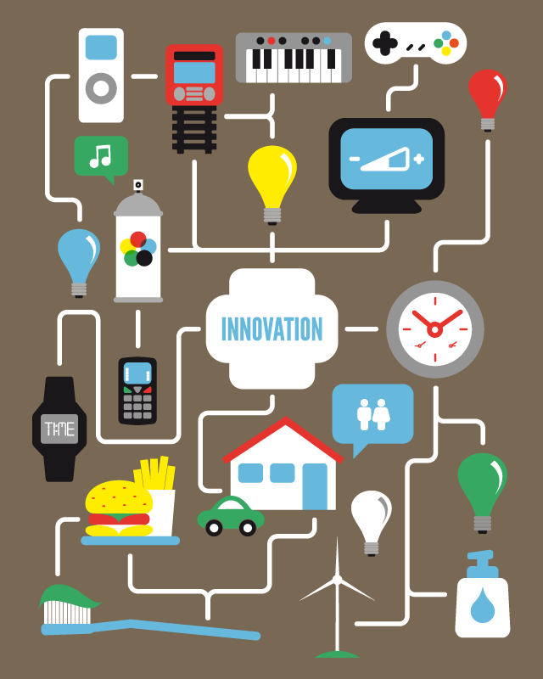
01 ​.01
Introduction to Innovation: Definitions, Concepts and Principles

Slide 2
Index
What is innovation?
Why does innovation matter?
Innovation Drivers
The 4 I's of the innovation process
Innovation types
  What is a business model?
The dimensions of innovation
Consequences of innovation
References

Slide 3
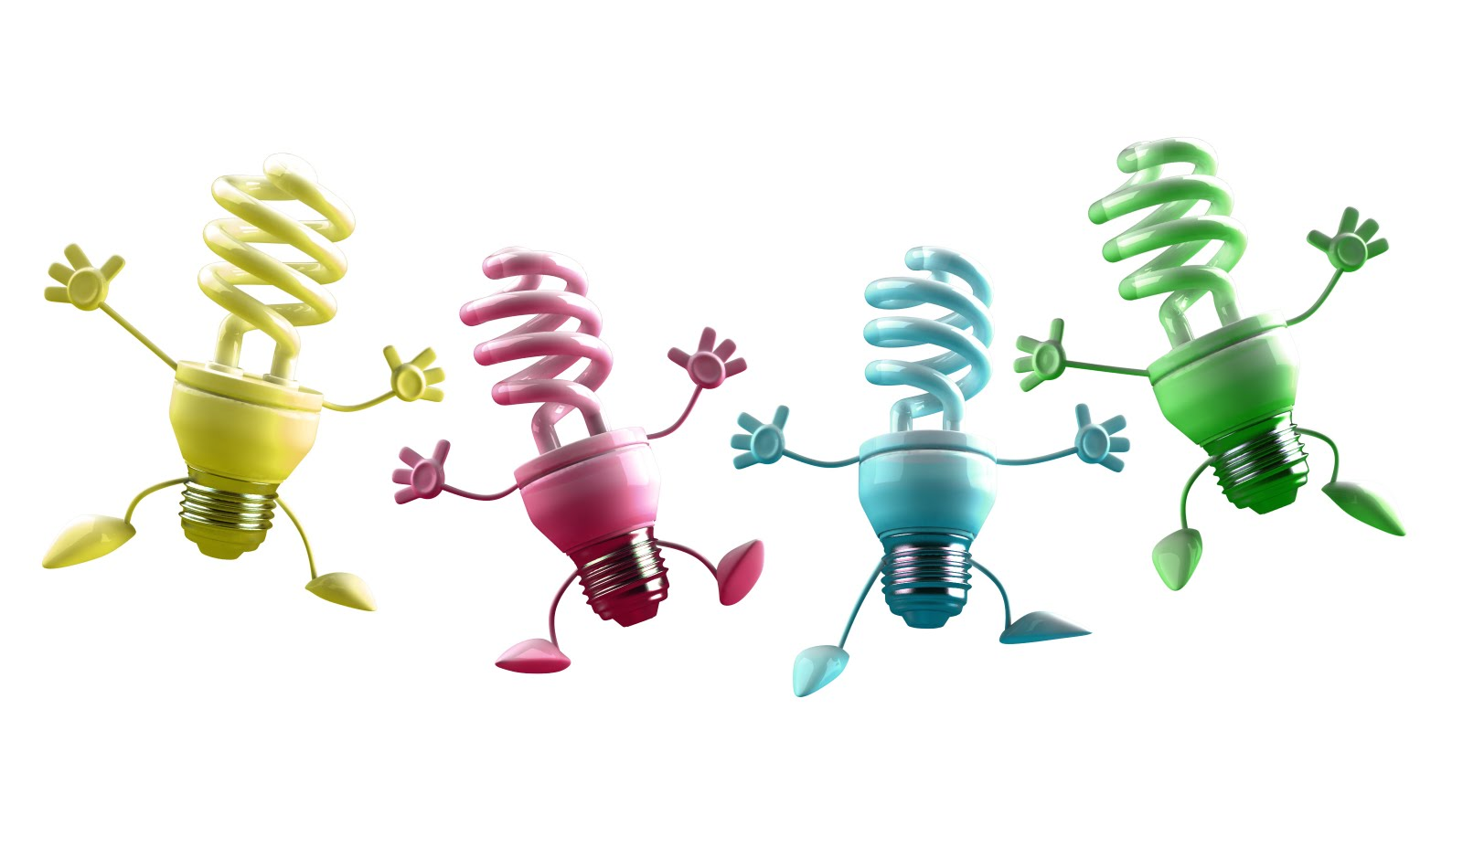
1. What is innovation?
Esta foto de Autor desconocido se concede bajo licencia de CC BY-NC-ND.

Slide 4
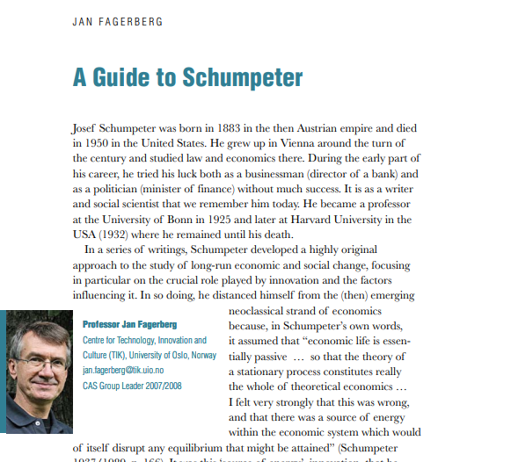
What is innovation?
Schumpeter argued that innovation comes about through new combinations made by an entrepreneur, resulting in:
  a new product,
  a new process,
  opening of a new market,
  a new way of organizing the business
  new sources of supply
Reading: “A Guide to Schumpeter” by Jan Fagerberg
You can find this article in the Virtual campus!

Slide 5
What is innovation?
Innovation in broad terms is any novel change that adds value to a product, a process, a service or to a company's operations.
Technological innovations
New product or part of a product
New procedures or manufacturing tools
Aesthetic innovations:
Product image or corporate image innovation
Business process or business model innovation
changes in the external appearance of a product (without changes in technology )

Slide 6
In short…
An innovative company is able to change
what it does (products and services),
the way it does it (processes),
its marketing strategies (market) and
its organizational structure (business model).

Slide 7

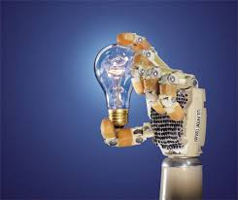

What is innovation?
THEORETICAL CONCEPTION
+
TECHNICAL INVENTION
+
COMMERCIAL EXPLOITATION
=
INNOVATION

Slide 8
2. Why does innovation matter?
Esta foto de Autor desconocido se concede bajo licencia de CC BY-NC-ND.

Slide 9
2. Why does innovation matter?
At present (globalization, crisis, strong competition...) it is not enough for companies to adapt to changes, they have to anticipate themselves.
Doing things right & producing quality goods and services is not enough, you have to be better than your competition.

Slide 10
Classical models of innovation
Scientific Discovery
invention
manufacturing
marketing
Science-Push approaches
  suggest that innovation procedes linearly:​​
Demand-pull approaches ​​
  Defend that innovation originates with unmet customer needs:​​
Customer suggestions
invention
manufacturing

Slide 11
3. Drivers for innovation
Esta foto de Autor desconocido se concede bajo licencia de CC BY-NC-ND.

Slide 12

3. Drivers for innovation
Financial pressures to reduce costs, increase efficiency, do more with less, etc
Increased competition
Shorter product life cycles
Value migration
Stricter regulation
Industry and community needs for sustainable development
Increased demend for accountability
Demographic, social and maket changes
Rising customer expectations regarding service and quality
Changing economy
Greater availability of potentially useful technologies coupled with a need to exceed the competition in these technologies

Slide 13
4. The 4 I's of the innovation process
Esta foto de Autor desconocido se concede bajo licencia de CC BY-NC-ND.

Slide 14
4. The four I’s of the innovation process
Innovation describes the discovery, development, and transformation of new knowledge in a four-step process captured in the 4 I's: ideation, invention, innovation, and imitation
ideation
invention
innovation
imitation

Slide 15
Ideation
The innovation process begins with an idea.
A new idea by itself, while interesting, is neither an invention nor an innovation, it is merely a thought
The idea is often presented in terms of abstract concepts or as findings derived from basic research.
  Basic research is conducted to discover new knowledge and is often published in academic journals.
  This may be done to enhance the fundamental understanding of nature without any commercial application or benefiting mind.
ideation

Slide 16
Invention
Invention is the transformation of an idea into a new product or process or the modification and recombination of existing ones.
The process of converting intellectual thoughts into a tangible new artifact is an invention. This is where science and technology play a significant role.
At this stage, inventions still need to be combined with hard work by many different people to convert them into products that will improve company performance.
ideation
invention
Notes:
A patent is a form of intellectual property that gives inventor exclusive right to benefit from commercializing a technology for a specified time period in exchange for public disclosure of the underlying idea.
Exclusive right often translate into temporary monopoly position until the patent expires. For instance many pharmaceutical drugs are patent protected.
Strategically, patents are a double edged sword.
Trade secrets are valuable proprietary information that is not in the public domain and where the firm makes every effort to maintain its secrecy. E.g., the Coca Cola recipe has been protected for over a century, or Ferrero-s Nutella. Google PageRank algorithm, or search one. Discovering how these algorithms work would nullify its advantage.

Slide 17

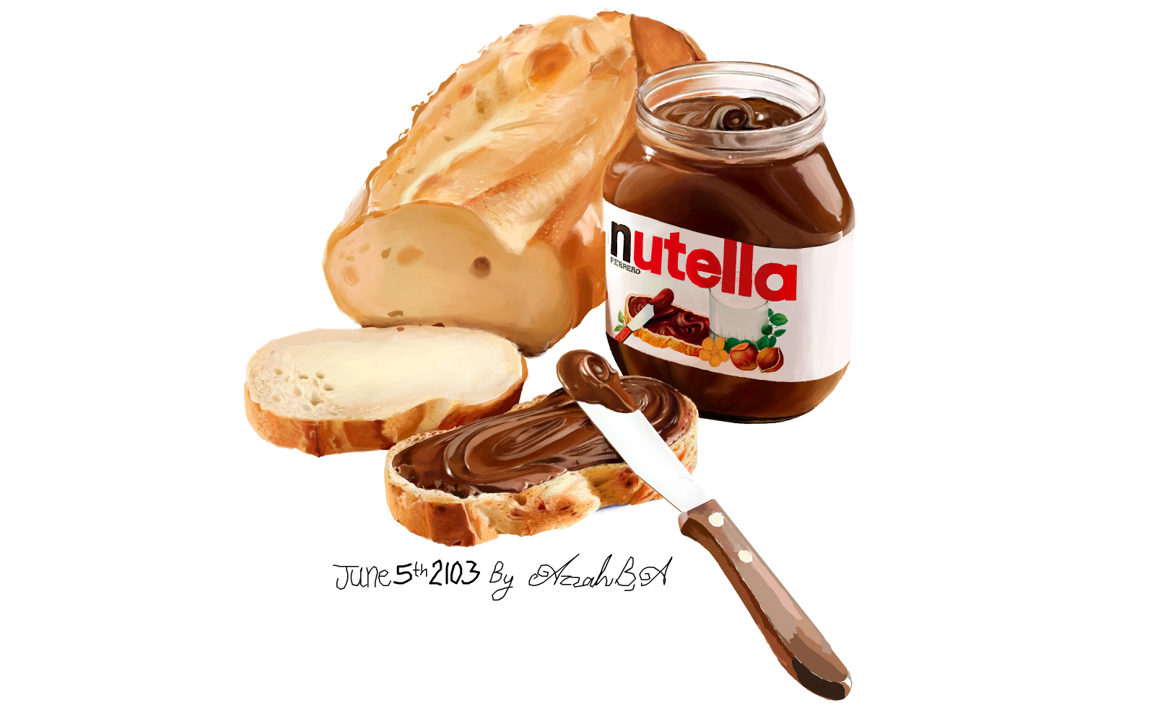
Invention
ideation
invention
Invention is the transformation of an idea into a new product or process or the modification and recombination of existing ones.
  If an invention is useful novel and non-obvious. It can be patented. In exchange for commercializing a technology in exclusive for a specified time period, the inventor must disclose the underlying idea. E.g., many pharmaceutical drugs are patent protected.
  Another option is not to disclose any info.
  Trade secrets have strategic value and are kept away from public domain. E.g., Ferrero’s Nutella, and Google’s PageRank algorithm.
Notes:
A patent is a form of intellectual property that gives inventor exclusive right to benefit from commercializing a technology for a specified time period in exchange for public disclosure of the underlying idea.
Exclusive right often translate into temporary monopoly position until the patent expires. For instance many pharmaceutical drugs are patent protected.
Strategically, patents are a double edged sword.
Trade secrets are valuable proprietary information that is not in the public domain and where the firm makes every effort to maintain its secrecy. E.g., the Coca Cola recipe has been protected for over a century, or Ferrero-s Nutella. Google PageRank algorithm, or search one. Discovering how these algorithms work would nullify its advantage.

Slide 18
Innovation
Innovation is the commercialization of any new product, or process, or the modification and recombination of existing ones.
In order to sustain competitive advantage a company must continuously innovate, it must produce a spring off successful products or services.
Novel
Implemented
Useful
INNOVATION
ideation
invention
innovation

Slide 19

Innovation - example
  Netflix began is life with a business model innovation: offering unlimited DVD rentals via the Internet without any late fees.
  It further developed its business model moving from online DVD rentals to directly streaming content via the Internet.
  Later on, Netflix started creating its own content by producing series such as House of Cards.

Slide 20



Imitation
The innovation process ends with imitation.
If an innovation is successful in the marketplace, competitors will try to imitate it.
Nowadays, there are various video on demand (VOD) services: HBO, Amazon’s Prime video, or Hulu in the US.
ideation
invention
Imitation
innovation

Slide 21
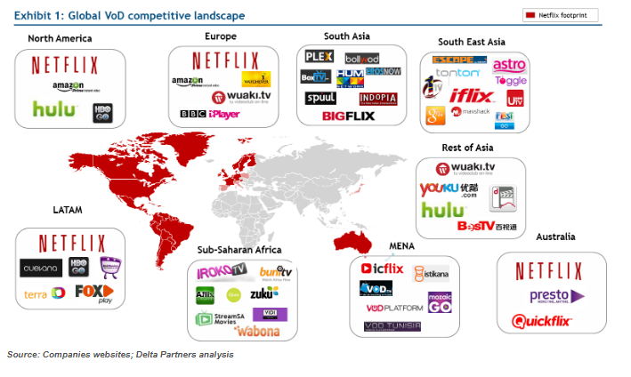
Source: Video on demand in emerging markets
https://www.deltapartnersgroup.com/video-demand-emerging-markets

Slide 22
5. Innovation types
Esta foto de Autor desconocido se concede bajo licencia de CC BY-NC-ND.

Slide 23
5. Innovation types
Process innovations are changes that affect the ways outputs are produced. E.g., just-in-time, mass customization, and simultaneous engineering.
Product innovations are changes in the actual outpus (goods and services).
Marketing innovations. Significant changes in product design, package design, distribution, promotion or pricing.
  The change does not affect the nature of the product or service or its functionalities.
  Goal: satisfy customers’ needs and wants
Business model innovations.

Slide 24
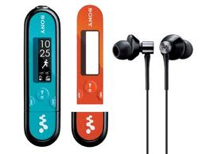
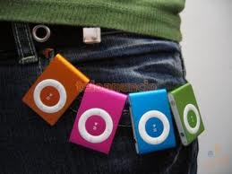
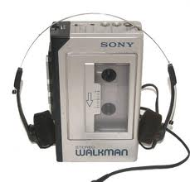
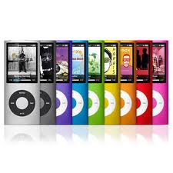
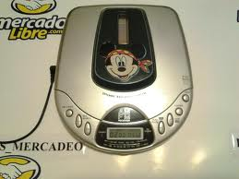
Examples: Product innovations
  Music storage has undergone a complete transformation. Each innovation implies the progressive disappearance of previous products (e.g. walkmans)

Slide 25
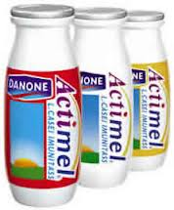
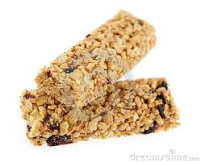
Examples: Product innovations
Food industry
  Actimel
  Cereal bars

Slide 26
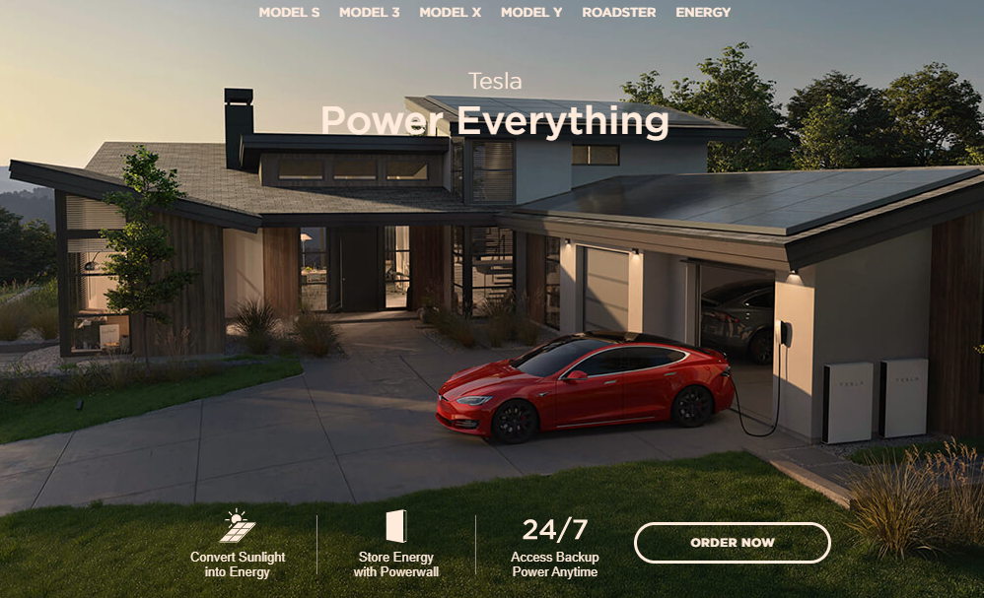
Examples: Product innovations
  Automobile industry: security improvement elements, navigators, connectivity, hybrid (HEV) and hybrid plug-in models (PHEV) as an intermediate step to full electric ones (EV).

Slide 27
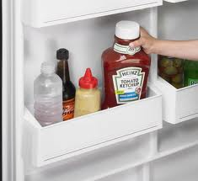
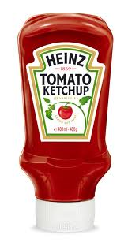
Examples: Marketing innovations
Food industry:
    Heinz: Top-Down ®, Fridge-door-fit ®

Slide 28
Collaborative activity: Marketing innovations
We live in an experience economy. Consumers
don’t want products, they want experiences.
Are you familiar with “experience boxes”
(“cofres experiencia”)?
  Smartbox
  Wonderbox
  La vida es Bella
  Plan B!
  DakotaBox
  Kaleidoscope
  ….
Exercise in class. In small groups, analyze one:
What do they offer?
How much? Cheapest and most expensive?
Target customers?
Which one would you choose for yourself? For your friends or family?
Distribution and Communication?

Slide 29
Collaborative activity: Marketing innovations
  What’s the lesson you have extracted of this
  analysis of the experience boxes available
  in the market?
  Are marketing innovation easy or difficult
  to replicate?
  Which I of the inno-
  vation process are
  these products in?
Exercise in class. In small groups, analyze one:
What do they offer?
How much? Cheapest and most expensive?
Target customers?
Which one would you choose for yourself? For your friends or family?
Distribution and Communication?

Slide 30
5.1. What is a business model
Esta foto de Autor desconocido se concede bajo licencia de CC BY-NC-ND.

Slide 31
BUSINESS MODEL CANVAS
 | RECURSOS CLAVE
How?
What?
Who?
¿€?
¿€?
Source: Osterwalder, A. y Pigneur, Y. (2011): Generación de Modelos de Negocios. Ed. Deusto, Barcelona.

Slide 32
Some business models…
Subscription
Intermediation
Razor-and-razor-blades (cebo y anzuelo) Gillette, printers, iPod /iTunes, Nespresso
Multilevel marketing
Avon, Tupperware, Tupper-Sex
Licencing
Loyalty
Dynamic prices
Wholesale
Coupons
“Freemium”
Pay-as-you-go. Telecom operators, electricity, water…

Slide 33
BUSINESS MODEL CANVAS
KEY PARTNERSHIPS | KEY ACTIVITIES | VALUE PROPOSITION |  | CUSTOMER RELATIONSHIPS | MARKET SEGMENTS
 | KEY RESOURCES |  |  | DISTRIBUTION CHANNELS
COST STRUCTURE |  |  | REVENUE STREAMS
Source: Osterwalder, A. y Pigneur, Y. (2011): Generación de Modelos de Negocios. Ed. Deusto, Barcelona.

Slide 34
Collaborative activities: BM Canvas
Collaborative activity 1. Case study – Apple's Ipod/iTunes
  Use a BM Canvas to analyze the case
  Paper, markers and sticky notes will be provided
Collaborative activity 2. Up to you
  Use the BM Canvas to analyze a product, service or company of your choice using the BM canvas, sticky notes and markers
  Use Canvanizer or Google Docs template to reproduce it digitally
  Answer the questions in the case.

Slide 35
6. The dimensions of innovation
Esta foto de Autor desconocido se concede bajo licencia de CC BY-NC-ND.

Slide 36
6. Dimensions of innovation
There are several types of innovation
  Product /service, process, marketing, business model
which can vary in degree of newness:
  Incremental to radical,
and impact:
  continuous to discontinuous
Discontinuous Innovation: A new product is launched, totally different from the previous, leading to a significant change in consumption habits.
Continuous innovation is more than just incremental changes. It relates to the ongoing, gradual evolution that occurs in our activities, operations, and creations.

Slide 37
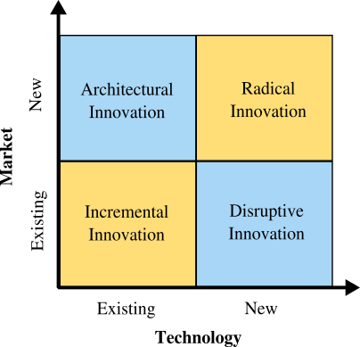
6. Dimensions of innovation
One way to classify innovations is to measure their degree of newness in terms of technology and markets.

Slide 38
Incremental vs. Radical innovation
Incremental Innovation
It is the most common form of innovation. It targets existing markets using existing technology.
Building on an established knowledge base, the company steadily improves an existing product or service. It employs existing technology to delivere increased value to the customer (features, design changes, etc.) within your existing market.
Most companies engage in incremental innovation in one way or another.
Examples include adding new features to existing products or services or even removing features (value through simplification).
Radical innovation.
It targets new markets with new technology.
Draws on novel methods or materials, it is derived from an entirely different knowledge base or from a recombination of the existing knowledge bases with a new stream of knowledge.
Examples, the introduction of mass/produced automobile (Ford T), the X ray, the airplane, or more recently genetic engineering.

Slide 39
Disruptive innovation,
It leverages new technologies to attack existing markets. It invades an existing market from the bottom up, segment by segment. Low end segments produce low benefits, but high end ones are very profitable.
also known as stealth innovation, involves applying new technology or processes to your company’s current market. It is stealthy in nature since newer tech will often be inferior to existing market technology. This newer technology is often more expensive, has fewer features, is harder to use, and is not as aesthetically pleasing. But, after a few iterations the newer tech surpasses the old one and disrupts all existing companies. By then, it might be too late for the established companies to quickly compete with the newer technology.
There are quite a few examples of disruptive innovation, one of the more prominent being Apple’s iPhone disruption of the mobile phone market. Prior to the iPhone, most popular phones relied on buttons, keypads or scroll wheels for user input.
Some authors contend that to be radical an innovation should have two aditional characterirstics:
It begins as a low/cost solution to an existing problem
Initially, its performance is inferior to the existing technlogy, but its rate of improvement over time is fast. Eg. Japanese carmakers first introduced small fuel efficient inexpensive cars, then moved to high end ones. Hynday and Kia have followed the same.
Eg. Google Android operating system, competing against Microsoft Windows (an opereating system for computers)

Slide 40
Architectural innovation
It leverages existing technologies into new markets. Since they have to reconfigure the components of a technology, they alter the architecture of the product.
A new product in which known components, based on existing technologies, are reconfigured in a novel way to attack a new market.
Taking the lessons, skills and overall technology and applying them within a different market. Eg. Memory foam
It gives birth to new industries (or swallows existing ones) and involves creating revolutionary technology. The airplane, for example, was not the first mode of transportation, but it is revolutionary as it allowed commercialized air travel to develop and prosper.
Example. Xerox was once the most dominant copier company worldwide. Highvolume, high quality, high price copy machines leased to customers through a service agreement. Great for big companies, but Xerox neglected SMEs. Cannon redesigned the machines by applying architectural innovation, so that no professional service was needed. Reliability was built into the machine and the user could replace the cartridge. This allowed cannon to apply the razor and razor blade business model.

Slide 41
7. Consequences of innovation
Esta foto de Autor desconocido se concede bajo licencia de CC BY-NC-ND.

Slide 42
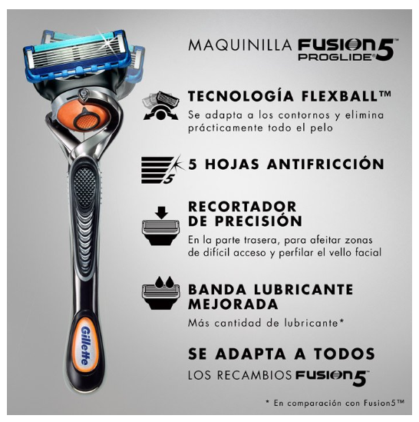
7. Consequences of innovation
A predictable pattern of innovation is that firms use radical innovation to create a temporary competitive advantage. They follow with a string of incremental innovations to sustain their initial lead. Eg. Gillette.
1903. King C. Gillette invented and started selling the safety razor with a disposable blade.
This radical innovation launched the Gilllette Co. (now a brand of Procter & Gamble)
Introduced the razor and razor blade business model
Continuously improved its razors (incremental innovations), adding additional blades.
Latest Gillet Fusion ProGlide with Flexball technology
Imitation is unavoidable
https://gillette.es/es-es/productos/afeitado/todas-las-maquinillas/fusion-proglide-flexball

Slide 43
7. Consequences of innovation
Over time these companies become the incumbents, whereas radical innovations are introduced by entrepreneurs.
Three reasons account for this turnaround:
Economic incentives. Once an innovator becomes the incumbent, it has strong incentives to defend its strategic position and market power. Incremental innovations strengthen their position and keeps entry barriers high. Furthermore, markets where network effects are important, turn into a winner-take-it-all markets, where the market leader captures almost all of the market share.

Slide 44
7. Consequences of innovation
Over time these companies become the incumbents, whereas radical innovations are introduced by entrepreneurs.
Three reasons account for this turnaround:
Organizational inertia. As firms become established and grow, they rely more on formal business processes and structures. In some instances, they experience resistance to changes in the status quo, and then do favor incremental innovations that reinforce the existing organizational structure and power distribution while avoiding radical innovations that could turn things around.

Slide 45
7. Consequences of innovation
Over time these companies become the incumbents, whereas radical innovations are introduced by entrepreneurs.
Three reasons account for this turnaround:
Innovation ecosystems. As incumbent firms become embedded in a network of suppliers, buyers, and other stakeholders, they no longer make independent decisions. They must consider the implications of their decisions on the rest of stakeholders in their innovation ecosystem. Steady incremental innovations reinforce these networks. New entrants are free of commitments, and do not need to worry about existing ecosystems as they will generate their own.

Slide 46

How can companies respond to disruptive innovation?
Continue to innovate in order to stay ahead of the competition. E.g. Amazon
Guard against disruptive innovation by protecting the low end of the market, by introducing low cost innovations to preempt stealth competitors.
Disrupt yourself instead of waiting for others to disrupt you. A firm might develop products for emerging markets and then introduce them into developed markets, in a process known as reverse innovation. Eg. GE-s Vscan a wireless ultrasound device.

Slide 47
